Slide 1
CSC 578 Neural Networks and Deep Learning
Fall 2018/19
5. TensorFlow and Keras
(Some examples adapted from Jeff Heaton, T81-558: Applications of Deep Neural Networks)

Slide 2
Intro to TensorFlow and Keras
TensorFlow intro
Using Keras
Feed-forward Network using TensorFlow/Keras
TensorFlow for Classification:
(1) MNIST
(2) IRIS
TensorFlow for Regression: MPG
Hyperparameters
(1) Activation
(2) Loss function
(3) Optimizer
(4) Regularizer
(5) Early stopping
Examples

Slide 3
1. TensorFlow Intro
TensorFlow is an open source software library, originally developed by the Google Brain team, for machine learning in various kinds of tasks.
TensorFlow Homepage
TensorFlow Install
TensorFlow API (Version 1.10 for Python)
TensorFlow is a low-level mathematics API, similar to Numpy. However, unlike Numpy, TensorFlow is built for deep learning.

Slide 4
Other Deep Learning Tools
TensorFlow is not the only game in town. These are some of the best supported alternatives. Most of these are written in C++.
TensorFlow Google's deep learning API.
MXNet Apache foundation's deep learning API. Can be used through Keras.
Theano - Python, from the academics that created deep learning.
Keras - Also by Google, higher level framework that allows the use of TensorFlow, MXNet and Theano interchangeably.
Torch - LUA based. It has been used for some of the most advanced deep learning projects in the world.
PaddlePaddle - Baidu's deep learning API.
Deeplearning4J - Java based. GPU support in Java!
Computational Network Toolkit (CNTK) - Microsoft. Support for Windows/Linux, command line only. GPU support.
H2O - Java based. Supports all major platforms. Limited support for computer vision. No GPU support.

Slide 5
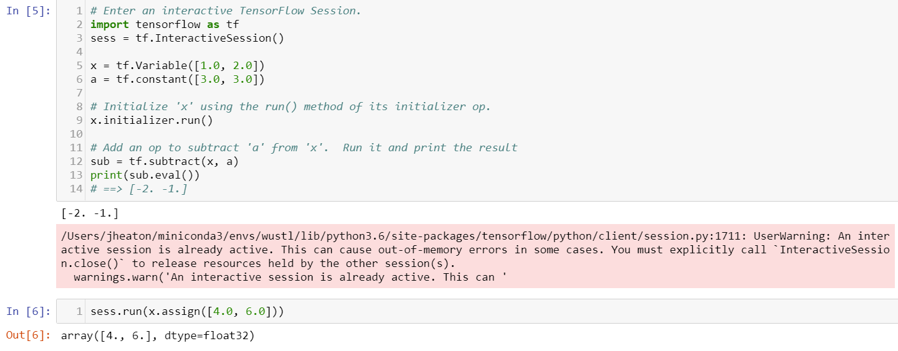
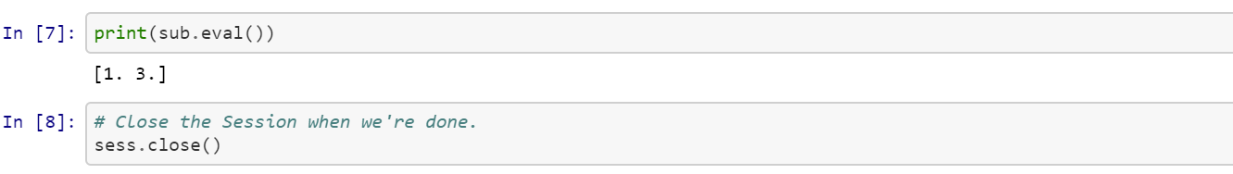
2 Basic TensorFlow
An example of basic TensorFlow (w/o ML or neural network; code link)

Slide 6
3 Using Keras
Keras is a layer on top of TensorFlow that makes it much easier to create neural networks.
It provides a higher level API for various machine learning routines.
Unless you are performing research into entirely new structures of deep neural networks it is unlikely that you need to program TensorFlow directly.
Keras is a separate install from TensorFlow. To install Keras, use pip install keras (after installing TensorFlow).

Slide 7
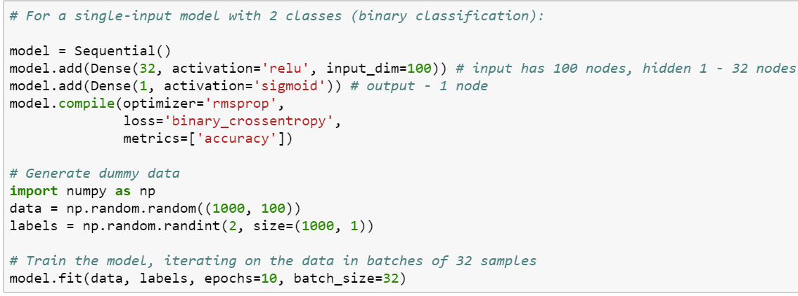
4 Feed-forward Network using TensorFlow/Keras
Keras Sequential model is used to create a feed-forward network, by stacking layers (successive ‘add’ operations).
Shape of the input layer is specified in the first hidden layer (or the output layer if network had no hidden layer). Below is an example of 100 x 32 x 1 network.

Slide 8
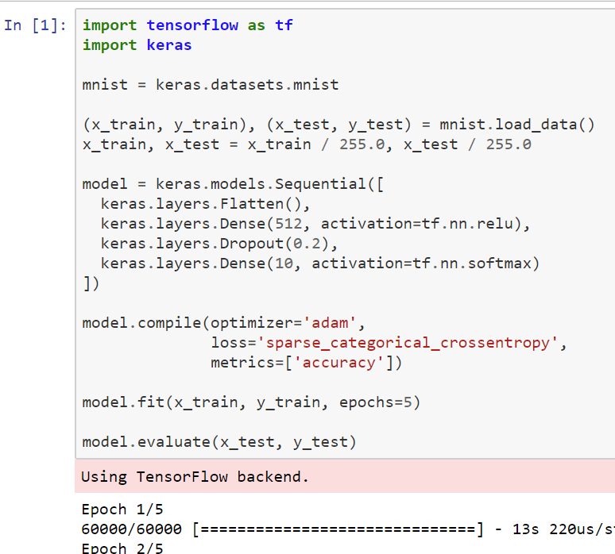
5 TensorFlow for Classification: (1) MNIST
Google’s TensorFlow tutorial. code link
Input 2D image is flattened to 1D vector.
Dropout (with the rate 0.2) is applied to the first hidden layer

Slide 9
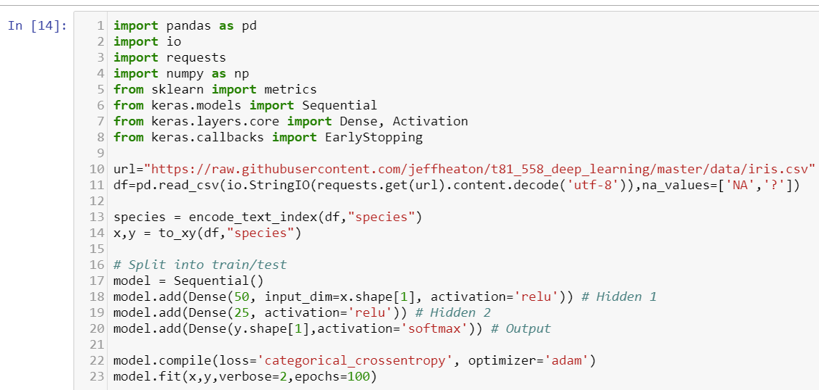
5 TensorFlow for Classification: (2) Iris
Simple example of how to perform the Iris classification using TensorFlow. code link Notice ‘softmax’ for the output layer’s activation function – IRIS has 3 output nodes, for the 3 types of iris (Iris-setosa, Iris-versicolor, and Iris-virginica).

Slide 10
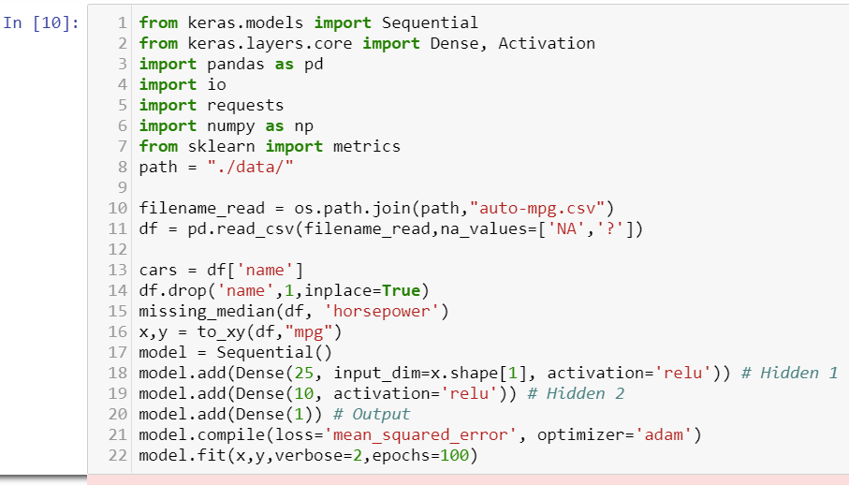
6 TensorFlow for Regression: MPG
Example of regressing using the MPG dataset [code link]. Notice:
The activation function at the output layer is none.
The loss function is MSE.

Slide 11
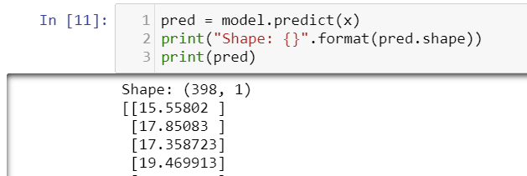
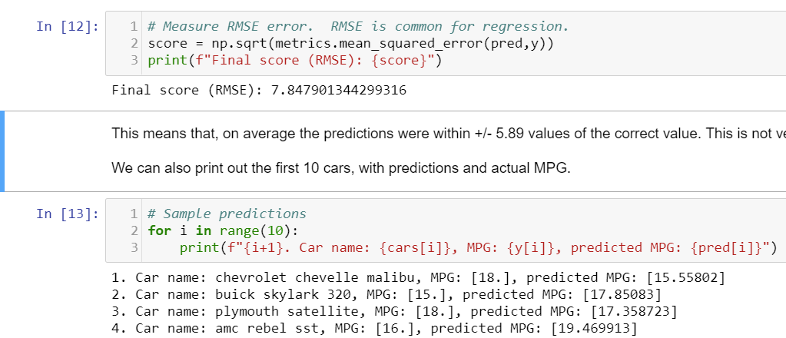

Slide 12
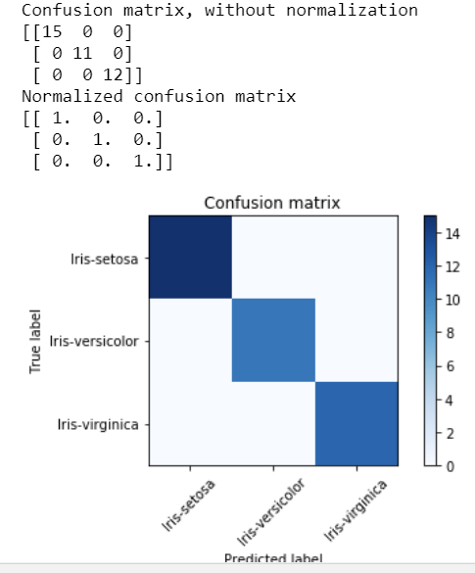
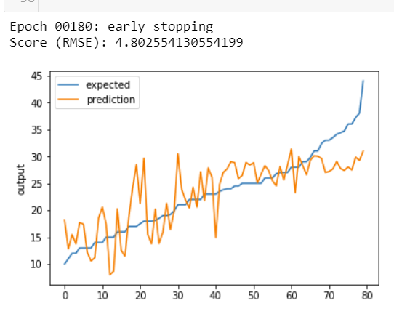
Some visualization of classification and regression [code link]:
Confusion matrix (for Classification) | Lift chart (for Regression)

Slide 13
7 Hyperparameters: (1) Activation
Activation functions (for neurons) are applied on a per-layer basis.
Available options in Keras:
‘softmax’
‘elu’ – The exponential linear activation: x if x > 0 and alpha * (exp(x)-1) if x < 0.
‘selu’ -- The scaled exponential unit activation: scale * elu(x, alpha).
‘softplus’ -- The softplus activation: log(exp(x) + 1).
‘softsign’ -- The softplus activation: x / (abs(x) + 1).
‘relu’ -- The (leaky) rectified linear unit activation: x if x > 0, alpha * x if x < 0. If max_value is defined, the result is truncated to this value.
‘tanh’ -- Hyperbolic tangent activation function.
‘sigmoid’ – Sigmoid activation function.
‘hardsigmoid’
‘linear’

Slide 14
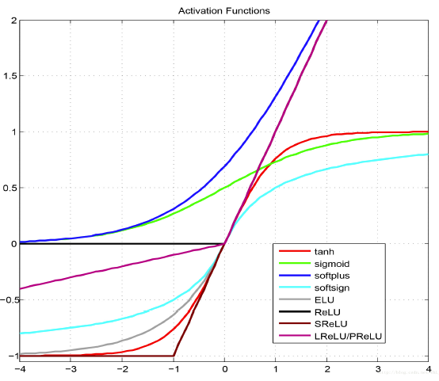

Slide 15
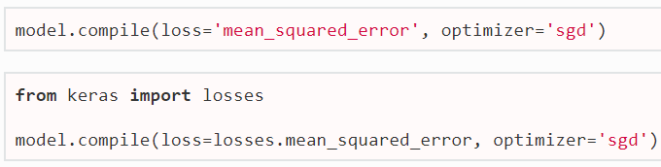
7 Hyperparameters: (2) Loss function
An optimizer is one of the two arguments required for compiling a Keras model:
Available options for cost/loss functions in Keras:
mean_squared_error
mean_absolute_error
mean_absolute_percentate_error
mean_squared_logarithmic_error
squared_hinge
hinge
categorical_hinge
logcosh
categorical_crossentropy
sparse_categorical_crossentropy
binary_crossentropy
kullback_leibler_divergence
poisson
cosine_proximity

Slide 16
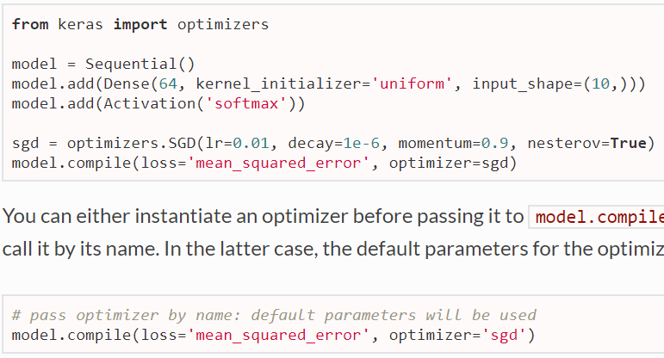
7 Hyperparameters: (3) Optimizer
An optimizer is one of the two arguments required for compiling a Keras model:
Several optimizers are available, including SGD and adam (default).
See the documentation for the various option parameters of each function.

Slide 17
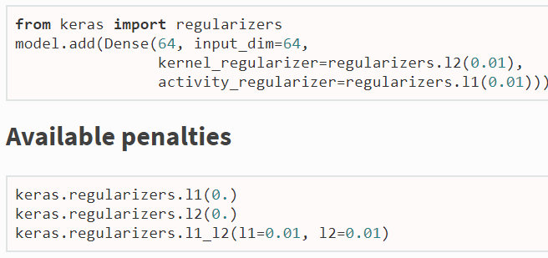
7 Hyperparameters: (4) Regularizer
Regularizers allow to apply penalties on layer parameters or layer activity during optimization.
The penalties are applied on a per-layer basis.
There are 3 types of regularizers in Keras:
kernel_regularizer: applied to the kernel weights matrix.
bias_regularizer: applied to the bias vector.
activity_regularizer: applied to the output of the layer (its "activation").

Slide 18
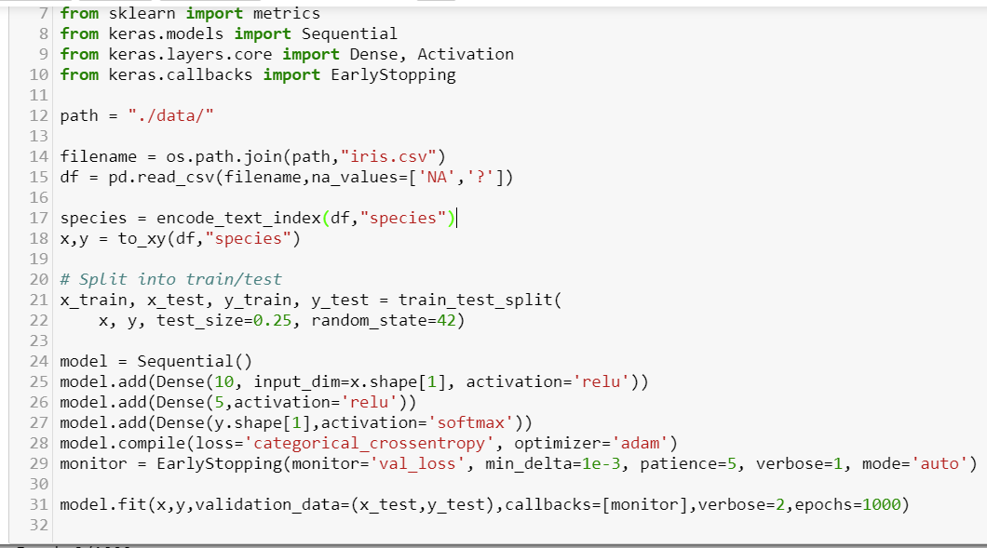
7 Hyperparameters: (5) Early Stopping
Example of early stopping. There are some parameters:
monitor – quantity to be monitored
min_delta -- minimum change in the monitored quantity to qualify as an improvement
patience -- number of epochs with no improvement after which training will be stopped.

Slide 19
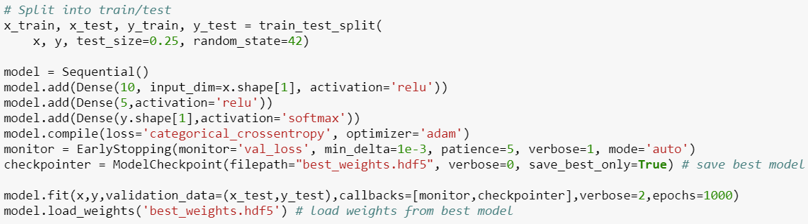
Early stopping with the best weights. This requires saving weights during learning (by using a ‘checkpoint’) and loading the best set of weights when testing.

Slide 20
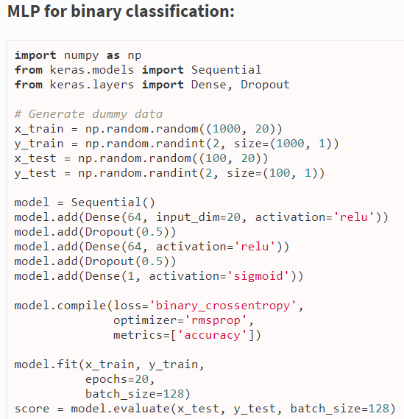
8 Examples

Slide 21
